Slide 1
INTERVIEW MANAGEMENT SYSTEM
TEAM ALPHA

Slide 2
Team MEMBERS
Aravindhan Ra
Darshana A
Deepika S
Gokul P
Kumaresh S
Prithvi Raj P
Remuki S
Sheik Fareeth H
Vinoth J
Project Duration in Days : 76 days

Slide 3
ABOUT THIS APPLICATION
Interview Management System is developed for the users inside our office.
The main purpose of this platform is to schedule drives and to collect the availabilities of the interviewers and to measure the performance of each interviewer.
Normal employee of the company will be the users.
Management person is the one who can view the performance of the interviewers of his/her department. So, this an extra privilege given to the users.
Admin is another user, who has the permission to verify the register user and allow the user to access the website and to manage the Departments, Locations, Projects and Roles of our company.

Slide 4
EXISTING CHALLENGES
It is very tough to organize a drive.
It is hard to find the availability of an interviewer.
It is hard to measure the performance of each interviewer.

Slide 5
SOLUTION and ARCHITECTURE
It is easy o collect the availability of the interviewers for the drive within a particular interval of time.
It is easy for an interviewer to track the performance.
It is helpful for a Management person to track his/her performance and to track individual interviewer’s performance as well.

Slide 6
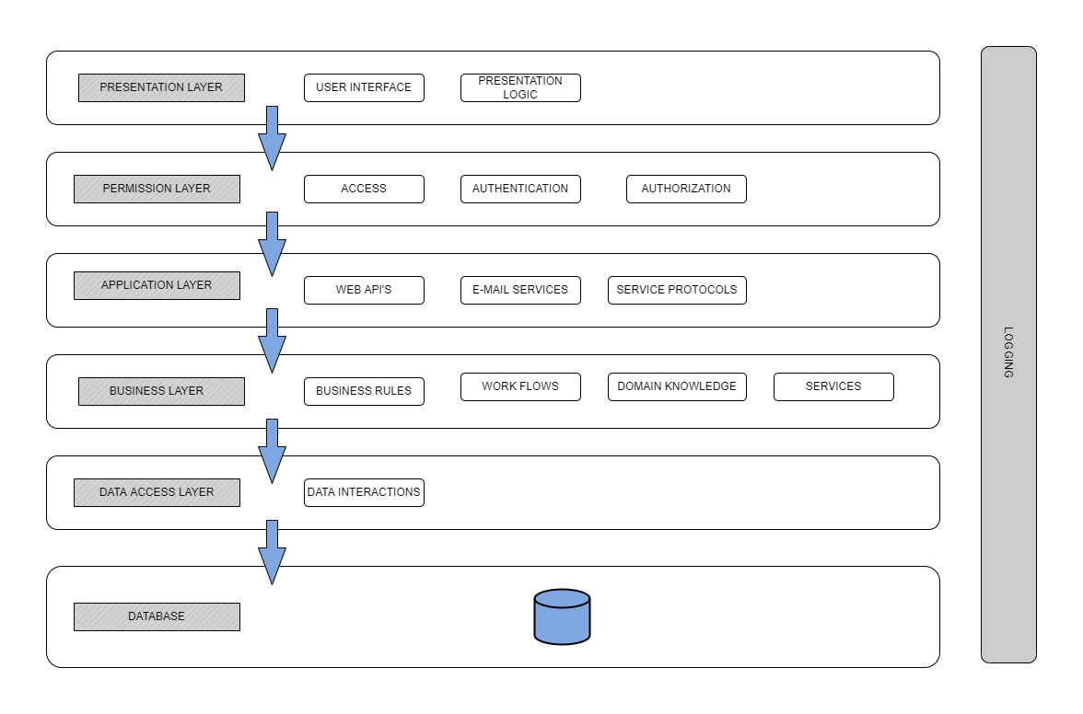

Slide 7
Execution journey
User stories
Functional and Non-Functional Requirements
Wireframe
HTML Template
Angular Components
Web API
Integration
Unit Testing
Set-up Documentation
SonarQube
Linting
Light House
Deployment in IIS
JMeter
High Level Design
Low Level Design
Test Scenarios

Slide 8
Artifacts
Areas | Link
Requirement – User Stories, Wireframes, Data Flow
Swagger - API
Data Model – EAR (Entity Attribute Relationship)
Test Scenarios
Sequence Diagrams
Defect Logs
Code Quality Metrics | Sonar and Lint reports
Setup Manual

Slide 9
TECHNOLOGIES & Tools USED
Asp Dotnet Core 6.0
Angular 13
Visual Studio Code
Node js
Angular
SonarQube
Jdk
JMeter

Slide 10
DEMO

Slide 11
LESSONS LEARNED
To understand the system of the project which we do.
Requirement gathering is the first-most thing to be done.
To think from the end-user’s perspective.
User-stories should tell about the flow of the system.
Wireframe should reflect the original output.
Set-up documentation should be written simple for the user manual for easy understanding.
Unused and Dead codes should be removed.
Comments should be added for understanding.

Slide 12
THANK YOU - Team alpha

